Slide 1
Social Studies
Essential UNIT Question: How did geography affect the development of the Eastern hemisphere?

Slide 2
Focus Question:
How did the geography of eastern Africa affect the development of human life?

Slide 3
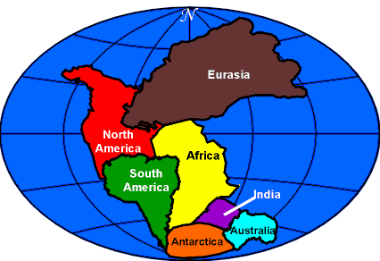
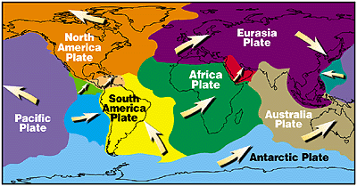
Geography in Motion:
Plate tectonics is the shifting of the Earth’s crust;
The Earth’s landforms once made up a single land mass called Pangea.
Through divergent and convergent movement, the Earth shifted over millions of years to form the present-day continents.

Slide 4
The Earth in 50 Million Years
Plate Tectonics are on-going and continue to shift the ground beneath our feet.

Slide 5
The Effects of Plate Tectonics:
The Earth cooled and climates changed.
As a result, continents like Africa lost many of its forests.
Fossil records show that an ape-like ancestor of man emerged from the de-forested areas of east Africa to walk on two legs. (4 million years ago.)

Slide 6
Eastern Africa’s Geography circa 4 MYA

Slide 7
Deforested Eastern Africa Following Climate Change

Slide 8
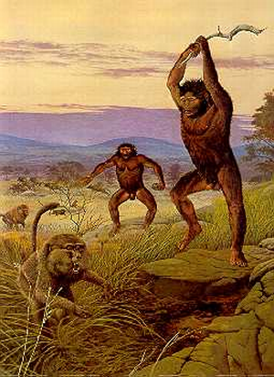
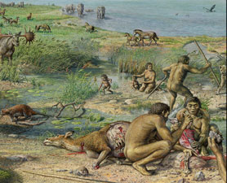
Survival of the Fittest

Slide 9
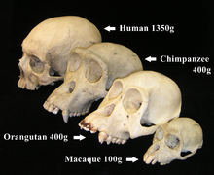
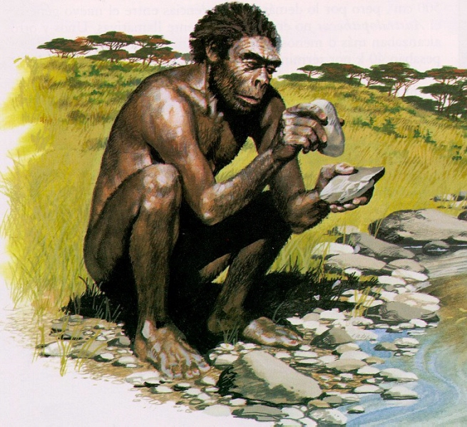
A Better, Smarter Version:
Larger brains
Opposable thumbs
Tool-making

Slide 10
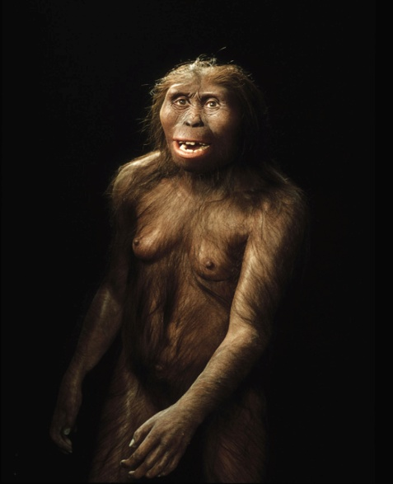
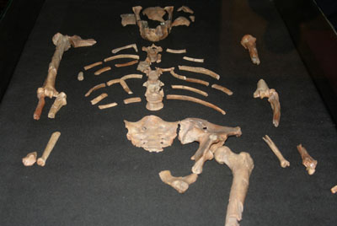
Geography Changed Everything!
Lucy

Slide 11
The Pre-History of the Human Race
Humans evolved (to change over long periods of time) to avoid extinction.
Humans developed bipedalism: To walk on two feet.
Humans developed stereoscopic sight: To see across great distances, which alerted them to predators.
Humans developed opposable thumbs to build tools out of stone and other materials.
Using tools made man more independent.

Slide 12
Activity:

Slide 13
What I learned . . .

